Slide 1
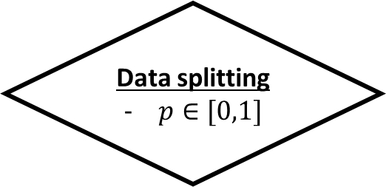
Raw playlist
user_id
tracks_id
n_listen
User filtering
n_list
n_tracks
Random selection
Filtered playlist
user_id
Tracks_id
n_listen
Data splitting
$p∈[0,1]$
Hidden playlist
user_id
tracks_id
n_listen
Tracks features
tracks_id
metadata
musical features
Apparent playlist
user_id
tracks_id
n_listen
Recom. algorithm
Random ranking
Average-based ranking (Avg-b)
Kmeans-based ranking (Km-b)
Avg-b artist filtered
Km-b artist filtered
Evaluation
- TPR(k), FPR(k)
ROC curve
AUC
Tracks ranked
user_id
tracks_id
ranks

